Slide 1
Sustainability in Action through the 2016 Lycoming College Environmental Audit
By Andrew Shelly ‘18

Slide 2
Table of Contents
Audit and Sustainability Background
Project Methodology
Results
Conclusions
Future Studies
Sustainability Programs on Campus

Slide 3
What is Sustainability Committee
Sustainability Committee is a student-run organization that promotes sustainable initiatives on campus.
These include: Terracycling, Recyclemania, Food Recovery, and Sustainability conferences.
Our mission statement is below: Lycoming College embraces the goals of sustainability for all of its stakeholder members and as an institution. We support the identification of sustainable practices for the sake of a sustainable community and world in a way that efficiently uses college resources.
Notes:
Future board members are Brittany Lenze (Head), Braeden Gonzales (Food recovery) and Mikayla Schappert (Terracycling)

Slide 4
What is the Environmental Audit?
The Environmental Audit to put it simply is a way for Lycoming College to measure the usage of electrical, water, and natural gas consumption on campus. The audit is a “living document” and began in 2007, with the 2017 edition currently in the works.
The audit also takes sustainability into account and examines the efforts that clubs and organizations, especially Sustainability Committee, are participating in on campus!
The entirety of this project is student led, which allows for Lycoming College Students to gain insight into the energy expenditures that occur on our campus.

Slide 5
Where can I find the Environmental Audit?
The Energy Audit is available on the Lycoming.edu website under “Sustainability” in the Student Life drop-down menu.
Next click on “Energy Audit” and the 2015 and 2016 documents are both displayed and able to be downloaded
Or follow the link! http://www.lycoming.edu/sustainability/environmentAudit.aspx

Slide 6
Audit Methodology
Data for the Audit is split into multiple categories: Water, Electrical, Natural Gas, and Solid Waste/Recycling.
Water data is obtained through the Williamsport Water Authority
Electrical and Natural Gas data is obtained through the companies PPL and UGI respectfully.
Solid Waste/Recycling data is obtained through Lycoming College’s garbage/recycling hauler
Data is maintained via Excel spreadsheets with pivot tables that allow us to create tables and information on data that is updated yearly.

Slide 7
Results: Campus Energy Use Totals
Notes:
I’m presenting 2016 data, working with Mikayla (Assistant, electric, gas?), Ruric (Water), Braeden, Katie, Anthony, and Sam

Slide 8
Total Electricity per year in Lycoming College 2007-2016
Notes:
Explain how we collect electricity. Use two companies, PPL and Constellation

Slide 9
Total Amount of water Lycoming College used from 2008-2016

Slide 10
Total Natural Gas Per Year in Lycoming College 2009-2016

Slide 11
Electrical Data for Campus Buildings2007-2016
Building groups are:
Academic Buildings, Apartments, Dorms, And Other Lycoming Campus Buildings

Slide 12
Total Electrical Energy Usage per Building group 2007-2016

Slide 13
Academic Buildings electrical usage from 2007-2016

Slide 14
Apartment electrical usage from 2007-2016

Slide 15
Dorm electrical usage from 2007-2016
Notes:
Explain Data Error for Williams/Commons. Explain remodeled building, Rich and Wesley.

Slide 16
Other Lycoming Buildings electrical usage from 2007-2016

Slide 17
Percent Electrical Consumption per Building Group at Lycoming College for 2016

Slide 18
Water Usage in Gallons/Square Foot (2008-2016): Graphical Displays
Academic Buildings, Apartments, Dorms, and Other Lycoming Campus Buildings

Slide 19
Academic Buiildings gallon/square foot water usage 2008-2016

Slide 20
Apartments gallon/square foot water usage 2008-2016

Slide 21
Dorm gallon/square foot water usage 2008-2016

Slide 22
Other Lycoming Buildings gallon/square foot water usage 2008-2016
Notes:
Long Hall Leak

Slide 23
Percent Water Consumption per Building Group at Lycoming College for 2016

Slide 24
Natural Gas Data Per individual building group unit 2009-2016
Building groups are:
Academic Buildings, Apartments, Dorms, And Other Lycoming Campus Buildings

Slide 25
Academic Buildings natural gas usage from 2009-2016

Slide 26
Apartments natural gas usage from 2008-2016

Slide 27
Dorm natural gas usage from 2009-2016

Slide 28
Other Lycoming Buildings natural gas usage from 2009-2016

Slide 29
Percent Natural Gas Consumption per Building Group at Lycoming College for 2016

Slide 30
Energy usage at the President’s House

Slide 31
Some conclusions we can make
Big Picture: Lycoming is trending downward in water and natural gas usage, but now is trending upwards in electrical usage.
Why could this be happening?
Renovations working effectively
Cost of natural gas
Student and faculty actions
Some variables that are hard to control in the audit are:
Seasonality
Occupancy (Academic Year vs Summer)
Renovations

Slide 32
Upcoming additions to the Audit!
This past year Anthony Mancuso and Samuel Lamport began working with a thermal imagery camera that specialized in detecting heat loss.
In the future this camera could help the administration target areas in buildings that need to be repaired, while also saving money on electric and helping the environment too!
Given that data continues to be collected over the years, a student or student could use statistical analysis to test if there are any significant changes in electrical, water, or natural gas usage.
Now that Lycoming College has purchase land for a Biology field station (off of route 87 on the Loyalsock Creek), there is the potential for the development of sustainable infrastructure (featuring solar panels) and a composting site.

Slide 33
Recyclemania Past Results
2016:
198/214 for total recycling
126/269 for per capita classic recycling
2015:
158/307 for per capita classic recycling
2014:
257/332 for per capita classic recycling
For more results follow the link: https://recyclemania.org/scoreboard/past-results/
Notes:
Competition going on right now!

Slide 34
Lycoming sustainability programs
Lycoming College Sustainability Committee
Food Recovery Network
Terracycling Program
LEAF Earth Week (Coming in April)
Campus Clean up Day! (Date TBA)
Single Stream Recycling
Rain Garden outside of Lynn Science Center
Wertz Dining Hall Renewable Cup system and To-Go boxes
Solar Panels (On top of Heim, we hope to expand to the Rec Center soon)

Slide 35
Terracyling
Terracycling is a program that takes “non-recyclable” items and allows them to be recycled.
Some of these include: solo cups, energy bar wrappers, empty shampoo or conditioner bottles, empty make up bottles, and cigarette butts just to name a few!
These items are collected in the Green Terracycling bins on campus and are sorted by members of the sustainability committee at the end of the semester to be weighed and shipped.
Find out more info at https://www.terracycle.com/en-US/ or through our Terracycle flyer file https://lycomingcollege.sharepoint.com/sites/LycoSustainability/Shared%20Documents/Terracycle%20Flyer.pdf

Slide 36
Food Recovery
Currently Food Recovery is occurring every day of the week besides Saturday! We hope to get this to 7 days a week soon!
Food Recovery takes the extra food that is not eaten and students from sorority and fraternity life and clubs and organizations bring it to American Rescue Workers.
As of today we have recovered 34,859 lbs of food!!

Slide 37
PERC Conference
Lycoming College is a member of PERC, which stands for the Pennsylvania Environmental Resource Consortium.
PERC has two conferences a year and Lycoming has won awards for our sustainability programs
Most of our fellow Pennsylvania private institutions are also in this program (like F&M and Dickinson). They constantly raise their sustainability efforts and we must as well!

Slide 38
Ways to improve Lycoming’s sustainability
More recycling bins outdoors around campus, expand from the one just next to the library?
A terracylcing bin (green) in each dorm room to go with each recycling bin
Recycling bins in communal bathrooms, helps make recycling easier for freshman especially
LEED certification for new building projects on campus
Rain Garden by the storm drain at Skeath
Composting project at the new College Property
Community Garden. Where should it be housed?
Bigger presence at Freshman weekend, make sure new students know some of the great programs at Lycoming!

Slide 39
Acknowledgments
Dr. Zimmerman, Dr. Smith
Lycoming College Biology Department
The 2017 Energy Audit Crew
Family
Friends
And you, the Audience

Slide 40
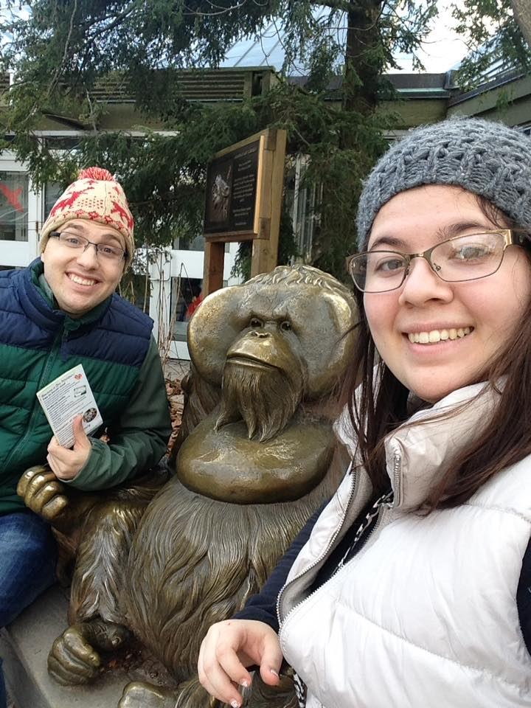
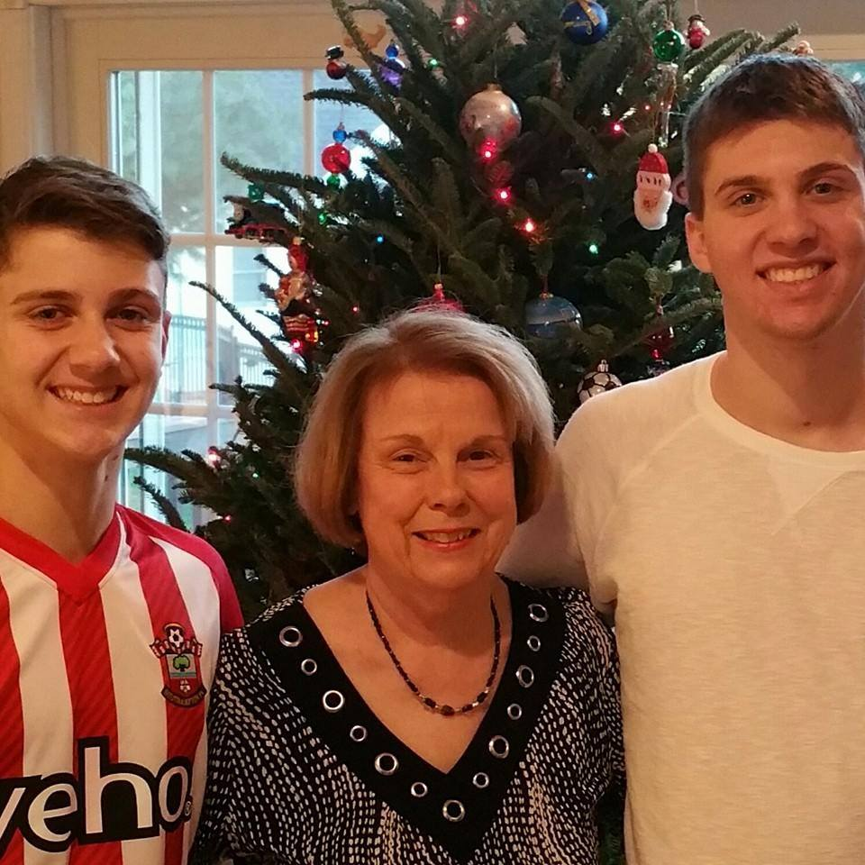
Questions?

